Slide 1

Social Media Marketing

Slide 2
Successful Social Media Strategy
Platform
Different target groups present on different social media platforms.
To reach out on the right platform
  E.g. Opinion Leader:- Twitter
  General Public:- ?
  B2B company targeting customers:-?

Slide 3
Successful Social Media Strategy
Implementation
Planning solves half the problem, real success only be achieve by implementation
Consist of two parts
  Timely posts:- Buffer.com, tweetdeck.twitter.com
  Reaction checks: e.g. ola cab ad “ too expensive to take girlfriend out on a date”

Slide 4
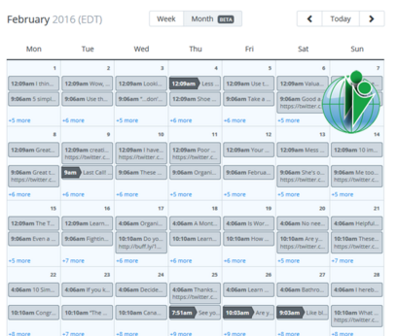
Implementation
Buffer

Slide 5
Successful Social Media Strategy
Measure
Measurement of social media performance is still evolving
Better approach to define the measurement metrics right at the beginning.

Slide 6
Successful Social Media Strategy
Measure
Social media metrics are;
  Conversion rate:- No. of comments/reach
  Amplification rate:- No. of shares/retweets/reach
  Applause rate:- No. of likes/reach
  Engagement rate:- Total Interaction/total reach
  Economic value:- Short term revenue + Long term revenue

Slide 7
Successful Social Media Strategy
Improve
Restructuring the strategy to meet the goals.
If the goals are met, then listening exercise should be repeated to establish new goals and a new campaign.

Slide 8
Successful Social Media Strategy
Video Case
  Marketing Case Insight 12.1: Spotify – YouTube
  Question
    What is the Spotify strategy to use Social media

